Slide 1


Audio Assist for the Blind
by
Akshay J Rai (USN : 4JK19EC006)
Aman Sasidharan KP (USN : 4JK19EC008)
Amrita Sinchana (USN : 4JK19EC009)
Yashas Shetty K (USN : 4JK19EC063)
Under the Guidance of
Mrs. Thrapthi Shetty
DEPARTMENT OF ELECTRONICS AND COMMUNICATION ENGINEERING
A J INSTITUTE OF ENGINEERING AND TECHNOLOGY
A Unit of Laxmi Memorial Education Trust ®
(Approved by AICTE, New Delhi, Affiliated to VTU, Belagavi, Recognized by Govt. of Karnataka)
Kottara Chowki, Mangaluru-575006, Karnataka
2021-2022

Slide 2
CONTENTS
Objective
Introduction
Block Diagram
Methodology
Result
Application
Conclusion

Slide 3
OBJECTIVE
Audio Assist for Blind navigation wearable system based on live image recognition and ultrasonic obstacles perception used as an audio assistance for blind people. The prototype is enriched with information obtained in real time by other sensors. A map lists these points and indicates the distance and direction between closer points. The blind users wear also glasses built with sensors like The Raspberry Pi Camera Board v2 is a high quality 8-megapixel Sony IMX219 image sensor custom designed add-on board for Raspberry Pi, ultrasonic enhancing the amount and quality of the available information. The user navigates freely in the prepared environment identifying the free path.

Slide 4
INTRODUCTION
Blind people may lose intention and have a higher risk of falling but people need to move whether at home, at work or addressing meeting. Most of blind people depend on other human for movement and environmental sensitivity. Blind people are suffering from lot of hardships in their daily life. The affected ones have been using the traditional white cane for many years which although being effective still has a lot of disadvantages.

Slide 5
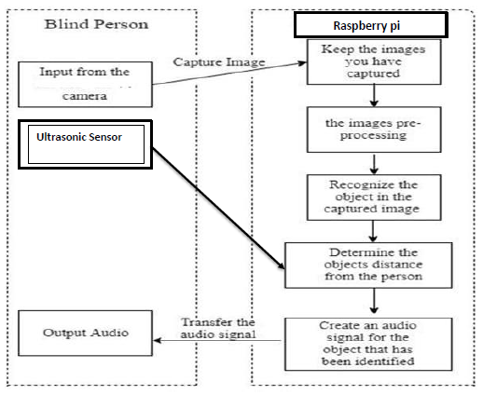
BLOCK DIAGRAM

Slide 6
METHODOLOGY
Obstacle detection
Obstacle Detection. To detect obstacles, we are using Ultra Sonic Sensor HC-SR04. Ultrasonic ranging module HC-SR04 provides 2cm to 4m non-contact distance measurement. The HC-SR04 module includes ultrasonic receiver, transmitter and control circuit.
The basic principle of working:
• Using I/O, trigger for at least 10µSec high level signal.
• Module automatically sends eight 40kHz pulses and detect whether there is an echo signal back to receiver.
• If the echo signal is back through high level, time of high output I/O duration is the time from sending ultrasonic signal to returning.
For the conversion of duration to distance. Obstacles Distance = (high level time*velocity of sound 340m/S) / 2

Slide 7
contd.
METHODOLOGY
Object detection & classification
Classification identifies objects by classifying them into one of the finite sets of classes, which involves comparing the measured features of a new object with those of a known object or other known criteria and determining whether the new object belongs to a particular category of objects.
which can be used to form the training set. Once the training set has been obtained, the classification algorithm extracts the knowledge base necessary to make decisions on unknown cases. Based on the knowledge, intelligent decisions are made as outputs and fed back to the knowledge base at the same time
----------------------------------------------------------------------------------------------------------------------------------
Text to speech
Speech synthesis is the artificial production of human speech. A computer system used for this purpose is called a speech computer or speech synthesizer, and can be implemented in software or hardware products. A text-to-speech (TTS) system converts normal language text into speech
----------------------------------------------------------------------------------------------------------------------------------
At the end all these data’s will be processed and then respective audio will be played to instruct the blind

Slide 8
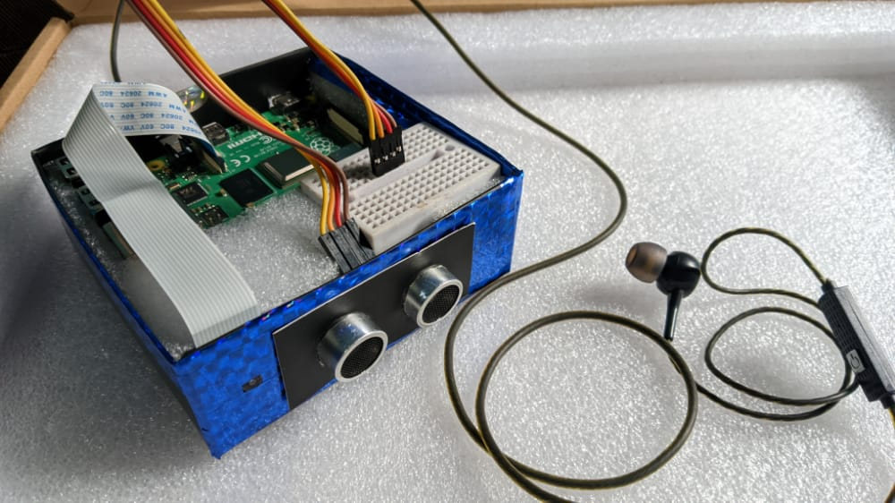
RESULT
Obstacle detection and Alert Message
The model can now detect obstacles in front of it and it can also give alert message in the form of audio through the earphone

Slide 9
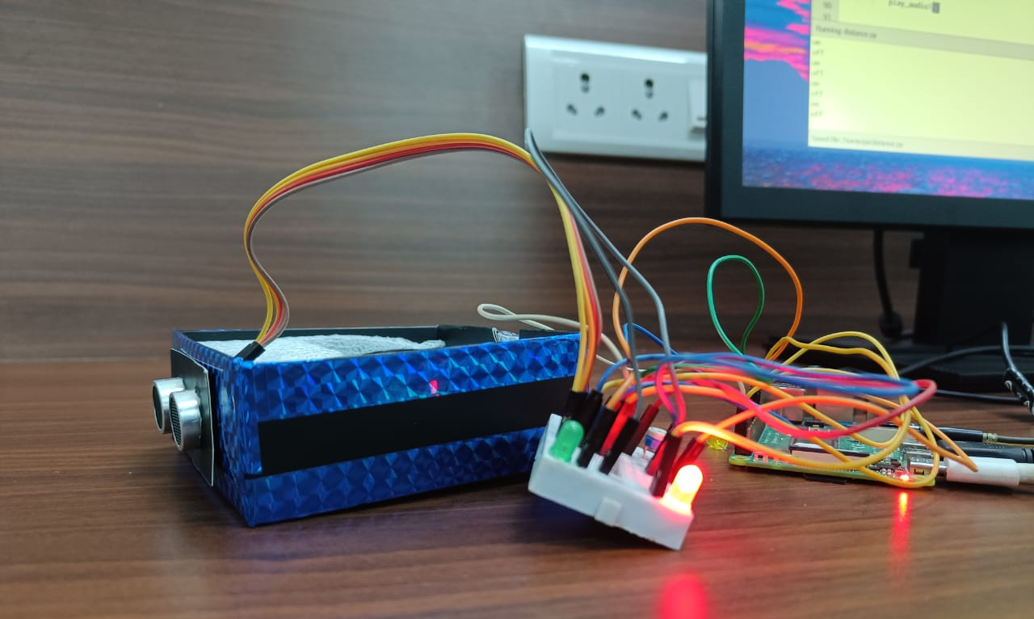
RESULT
Object recognition and Classification
The algorithm now can detect and recognize the object in an image and labels it accordingly. When connected to a display device it can display the label of the recognized object.

Slide 10
APPLICATION
Assistance through audio to the blind can be used in the following fields
• Blind schools
• Industries
• Home
• Public places

Slide 11
CONCLUSION
This report gives an overall view of the prototypes which have been implemented and yet to implement. Survey of all the assistive devices which helps the visually impaired person has been done. It consists of problems which the visually impaired people are facing in their dayto-day life and solution to these problems has been given. Based on the survey the systems are advanced to help the blind in various fields so that they can be independent and do their work on their own.

Slide 12
THANK YOU

